Slide 1
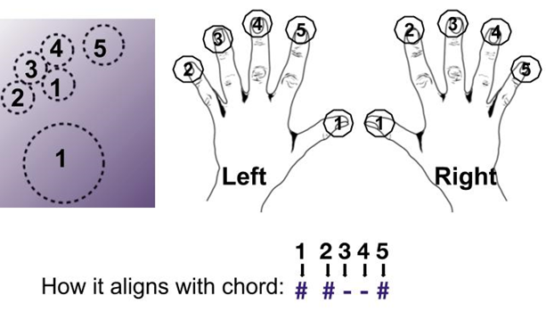
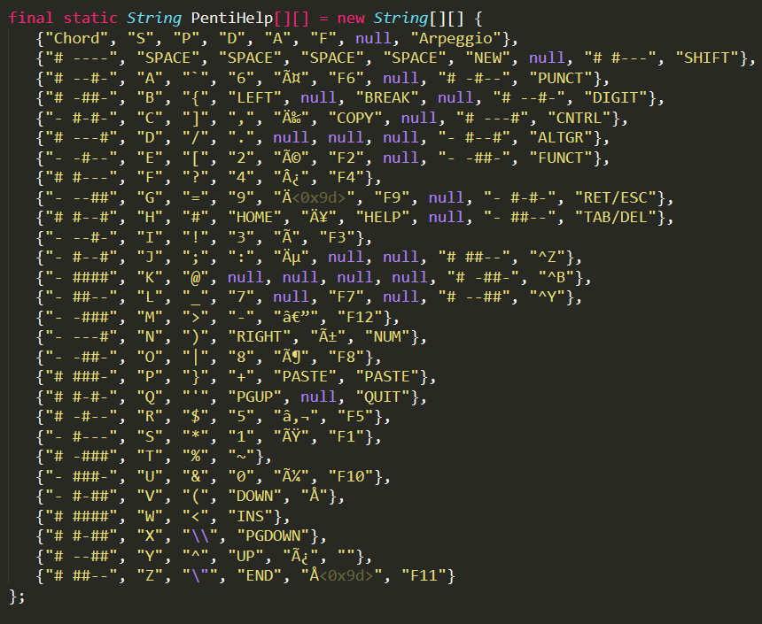
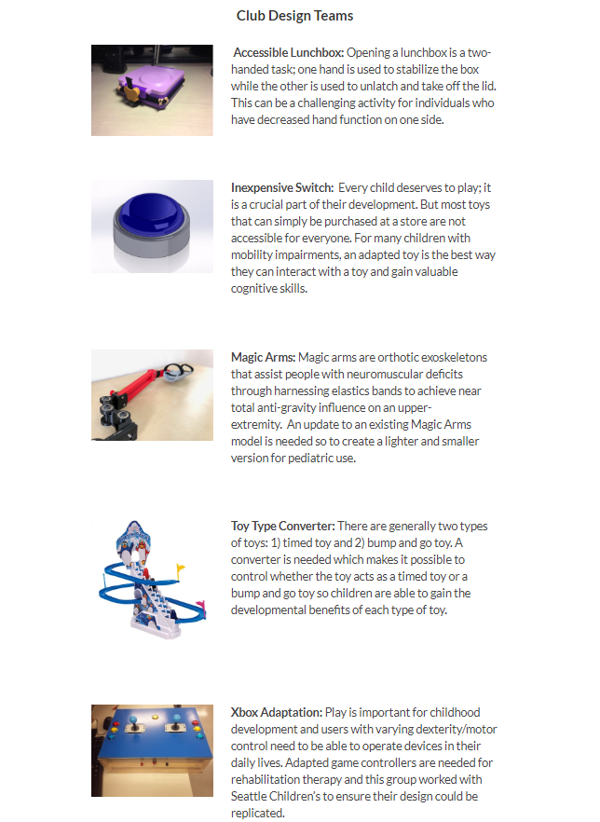
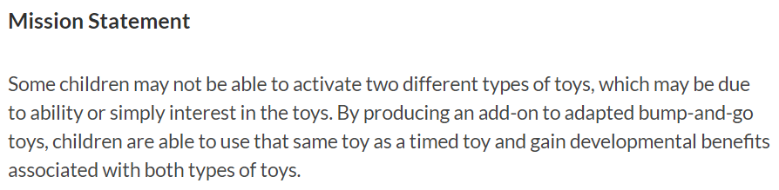
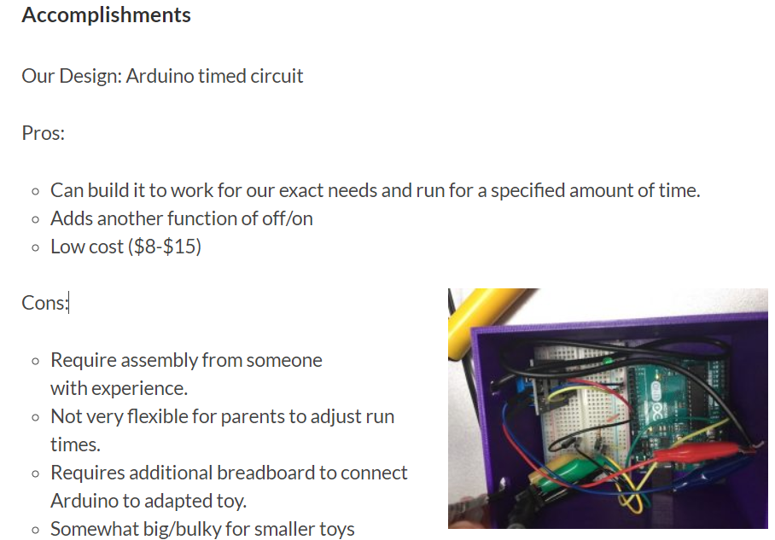
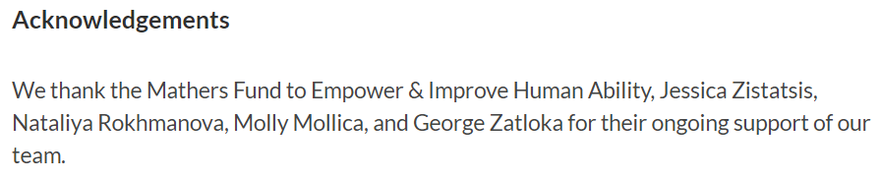
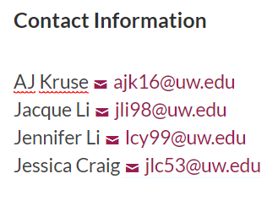
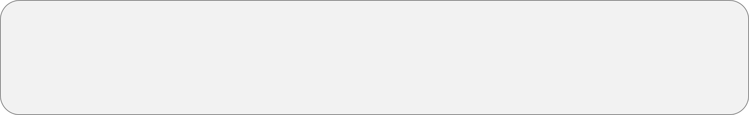
Size of font
Establishing an inclusive and sustainable design program for assistive technology
Joseph J. Lawler¹, Keshia M. Peters¹, Alyssa Spomer and Katherine M. Steele ¹
¹Mechanical Engineering, University of Washington, Seattle, WA
²Electrical Engineering, University of Washington, Seattle, WA
Background
HuskyADAPT is a program at the University of Washington that works to foster an inclusive, sustainable, and multidisciplinary community supporting accessible design and play technology. Each year student teams work with community members on projects focused on accessible design. This is important because we are teaching the next generation of engineers to make technology accessible and helping community members along the way. I worked to ensure that last year’s work did not go to waste and the program continues its success.
Website
Design Challenges 2018-2019
Furthering a Design Project
How do we ensure sustainability of projects between years?
How do we share results with the broader community?
How do we reach out to need experts for project ideas and partnerships?
How do we pick projects for impact?
Is there any design project or piece of a project you would like to pursue or prepare it for another design team?
Design Project:
Queso is a super third grader! He is looking for better ways to play more challenging video games. He is especially interested in being able to play Minecraft with only his left hand.
With this implementation the student’s writing potential will expand exponentially.
Easy Type:
Customized PENTI One-handed Keyboard
Minimal force required to type due to touch keyboard, opens doors to playing online games
Allows Queso to grow typing skills
Regular PENTI keyboard implementation and Simplified PENTI keyboard for games
Continuation:
Researched most used keys to optimize keyboard
Implemented shortcuts for most used words in users age group
Remapped the keyboard according to Queso’s ability with his right hand
Before:
Short summaries of most of the teams, incomplete
Stated design challenges but did not showcase results
Lacked necessary information for other research teams to pick up where they left off; did not promote sustainability
Process:
Performed Case Studies on other research pages
Selected information to be posted; in line with guiding questions
Organized with user interaction in mind
Final Product:
Central pages for Club and VIP teams; links to team pages
Hardcoded features in HTML5: Hover and Alignment
Added Accessibility features: Alt text and Read-out
Before:
Difficult to navigate to Design Challenge survey
Survey did not set expectations or gather enough information
Student teams were given a short summary of their design challenge
After:
Survey is available via link from the homepage of the website
Survey is inclusive and sets expectations for need experts and teams; incorporated feedback from experts in the field
Centralized repository of community members contact information
Created interview document for meetings with need experts to ensure the correct information is gathered
One page summary of each design challenge for incoming student teams providing more direction and detail
Future:
Separating design challenges into the VIP class or club format
Documentation to be used in the future, ensuring the continuation of accessible design
Expand our network of community members, continuing to increase the impact that HuskyADAPT can have.
Student teams and need experts are set up for success by establishing realistic expectations and desired outcomes before the design process even starts.
Iterated upon an existing design to improve the user experience and versatility of the keyboard.
The website workflow is now more intuitive and organized making the information accessible, ensuring the sustainability of accessible design.
References
Acknowledgments
Sample font size
I would like to thank Keshia Peters, Alyssa Spomer and Dr. Steele for their advice and direction throughout this project. I also thank the Mathers Fund to Empower and Improve Human Ability for their on-going support of HuskyADAPT.

